Slide 1
Advanced Networking Lab: Feedback on 5G Labs
2023-2024
Johan Bergs, Michael Peeters, Arno Troch

Slide 2
Overview
Where we are now

Slide 3
Lab Structure: Status
Lab | Timeline
Lab 1: Pre-reading | 15 April – 21 April
Lab 2: Basic Design | 22 April – 28 April
Lab 3: RF Planning | 29 April – 5 May
Deadline Labs 1-3: Sunday, 5 May 2024
Deadline Labs 1-3 Feedback: Friday, 10 May 2024
Lab 4: Configuring OpenAirInterface | 6 May – 12 May
Lab 5: Running OpenAirInterface | 13 May – 19 May
Lab 6: OpenAirInterface Walk Test | 20 May – 26 May (@ The Beacon)

Slide 4
Lab 6: OpenAirInterface Walk Test
Wednesday, 22 May 2024
10:00 – 12:00: Group 2
14:00 – 16:00: Group 1
@ The Beacon
Sint-Pietersvliet 7, 2000 Antwerp

Slide 5
Feedback
5G Labs 1-3

Slide 6
Lab 2: Basic Design
Minimum & maximum distances
Minimum distance
= shortest possible distance between UE and RSU
Maximum distance
= largest distance between UE and RSU that you want to support
Explain your choice!

Slide 7
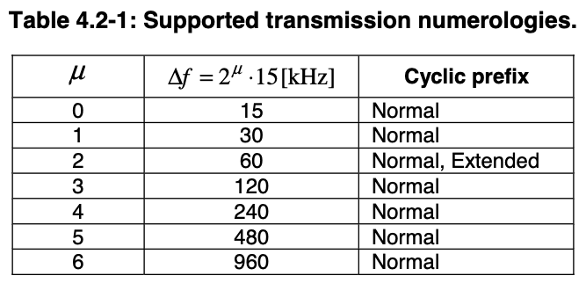
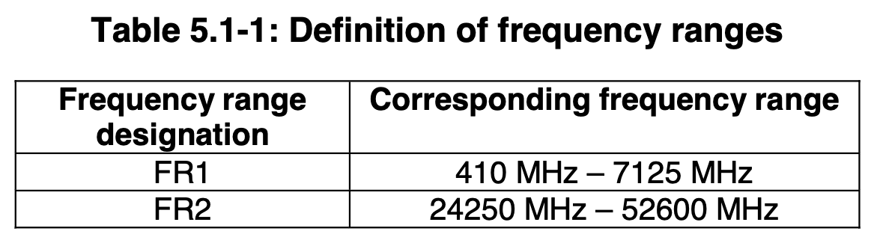

Lab 3: RF Planning
Numerologies
Possible values: 0-6
But:
FR1: $μ∈\left\{0, 1, 2\right\}$
FR2: $μ∈\left\{2, 3, 4, 5^{∗}, 6^{∗}\right\}$ *optional
Possible $μ$ depends on NR band
See 3GPP TS 138.101-1, Table 5.3.5-1: “Channel bandwidths for each NR band”
3GPP TS 38.211 version 17.1.0 Release 17
3GPP TS 38.101-1 version 17.5.0 Release 17

Slide 8
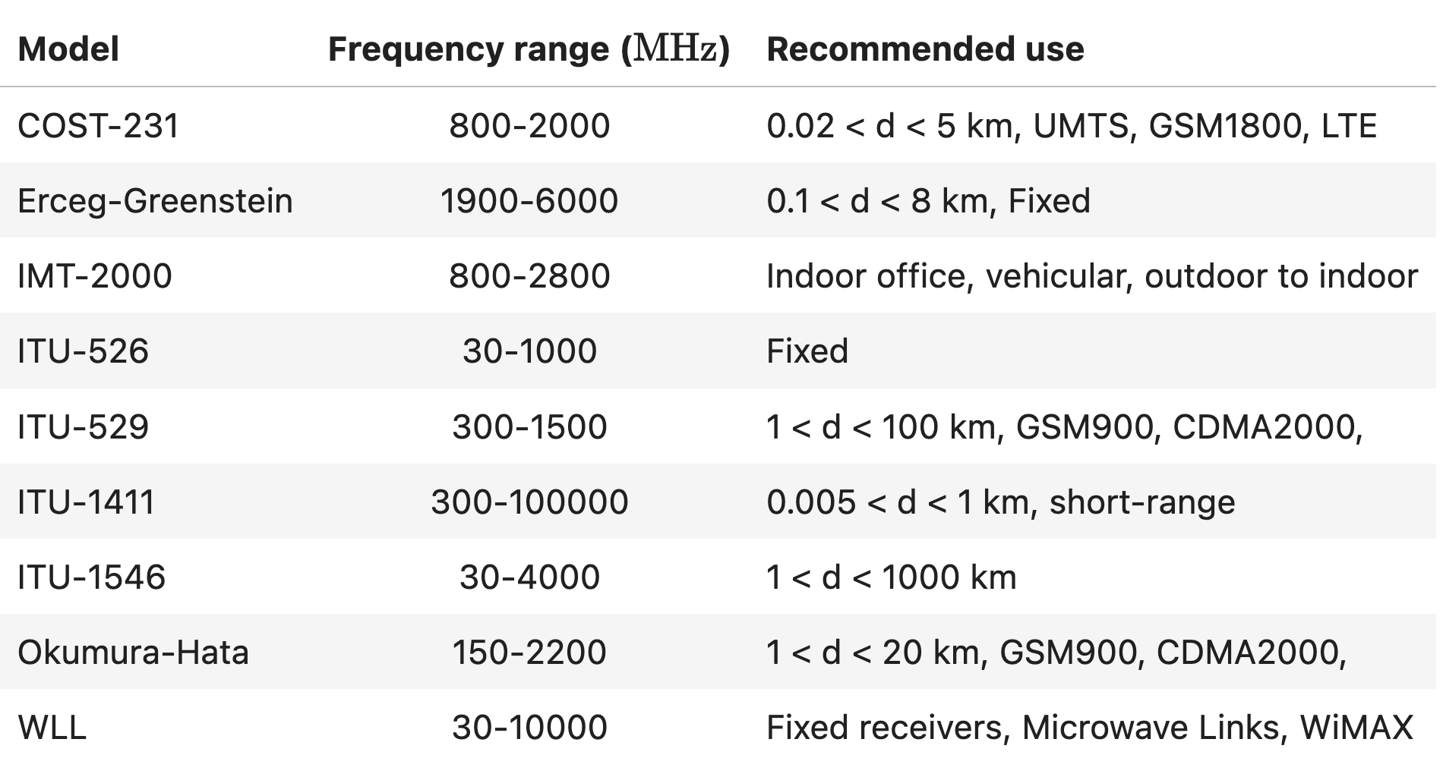
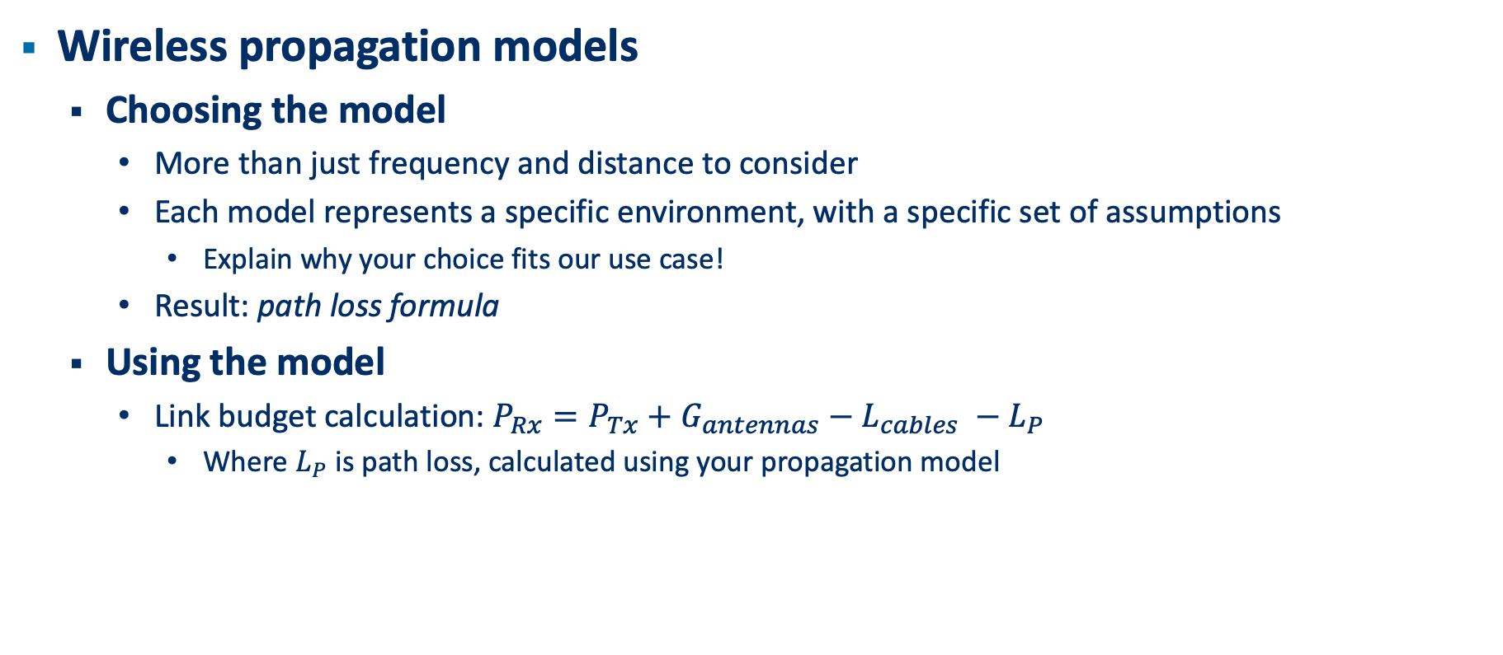
Lab 3: RF Planning
Wireless propagation models
Choosing the model
More than just frequency and distance to consider
Each model represents a specific environment, with a specific set of assumptions
Explain why your choice fits our use case!
Result: path loss formula
Using the model
Link budget calculation: $P_{Rx}=P_{Tx}+G_{antennas}−L_{cables} −L_{P}$
Where $L_{P}$ is path loss, calculated using your propagation model

Slide 9
Final Remarks
References!
Especially if you quote or paraphrase
Doesn’t have to be fancy – link is fine

